Slide 1
Software Testing (Advanced)
Week 6

Slide 2
Testing before Developing
Can we test our code without implementing it?
What can we do if my friends are too slow in implementation, yet I want to test my code which depends on theirs?
How do I test my code that uses third-party library?

Slide 3
Idea
Mock their code, yet not implement it

Slide 4
Mock Objects
What if you are working a component, which relies on your teammate’s component. Unfortunately, your teammate (as always) is not as efficient as you are. Can you test your program now?
CalculatingMachine.java; TestWithMock.java

Slide 5
Invocation on Expectations
exactly(N).of
N invocations
atLeast(N).of
>= N invocations
atMost(n).of
<= N invocations
Between(Min, Max).of
Min <= invocation <= Max
Never
Zero invocation

Slide 6
Exercise 1
Given Sorter.java and FindMaxUsingSorting.java, write a test case for method FindMax without implementing Sorter.java first.
TestSortingWithMock.java

Slide 7
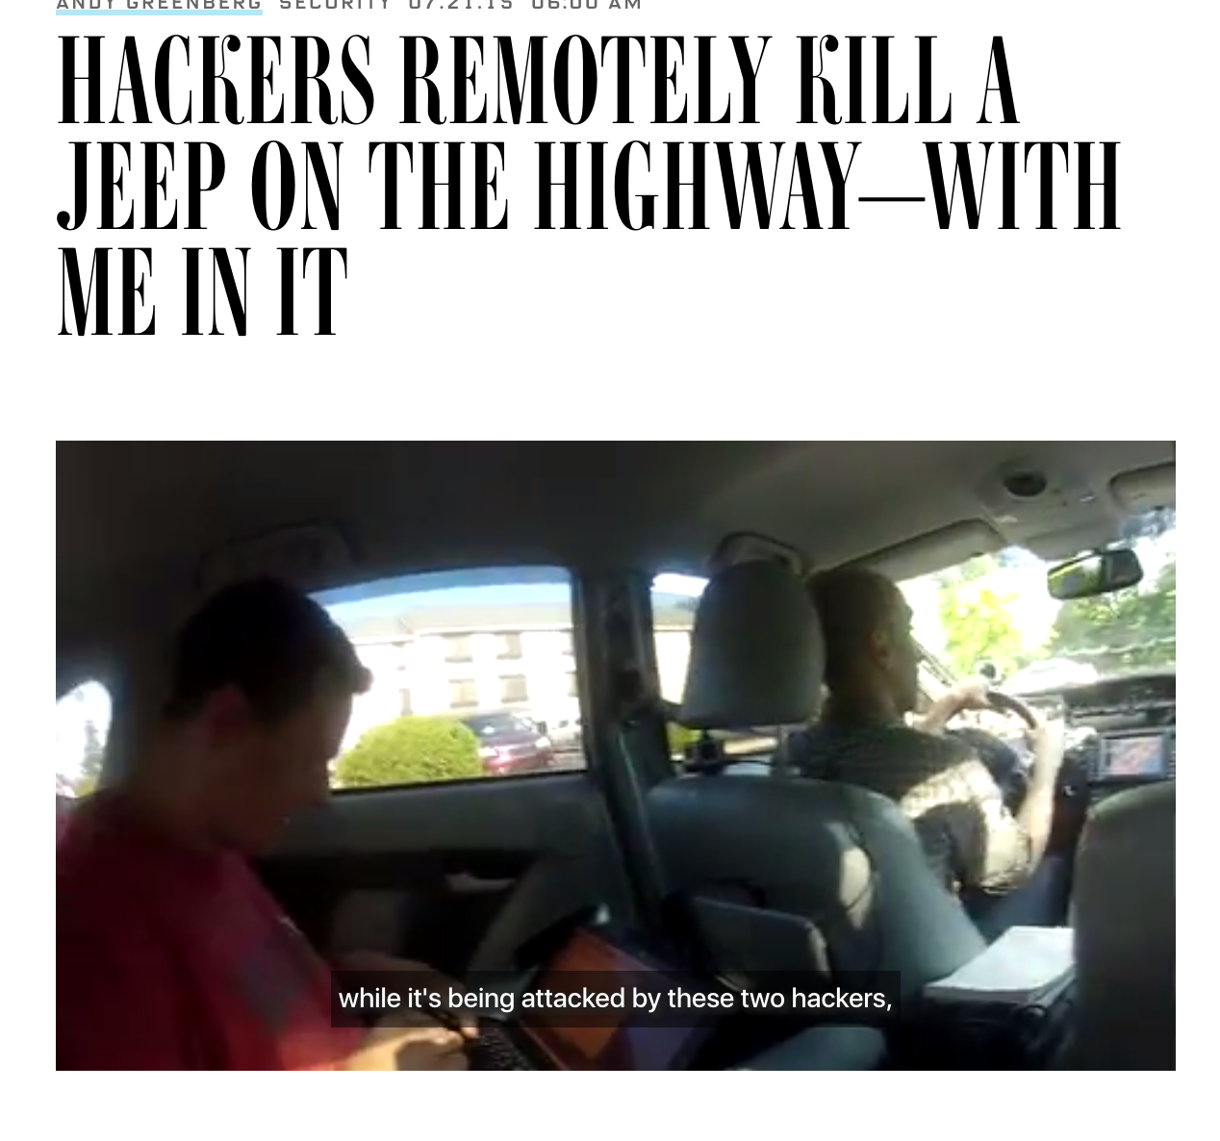
Software Security

Slide 8

Software Security

Slide 9
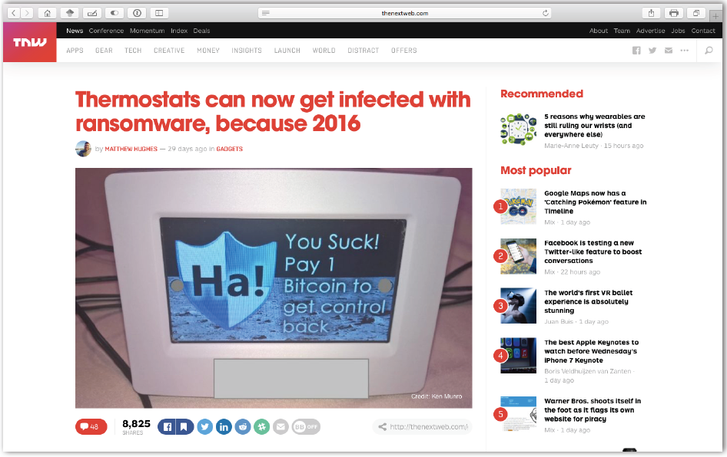
Software Security

Slide 10
A Simple Vulnerability
while ((read = getch()) != ‘\0’)
{
name[id++] = read;
…..
}
getch() reads input from standard input terminal

Slide 11
A Simple Vulnerability
name[0]
name[1]
char name[100];
while ((read = getch()) != ‘\0’)
{
name[id++] = read;
…..
}
name[100]
Overwrite with
address holding
attacker code
Overwrite return
address with
name[>100]
Return address
getch() reads input from standard input terminal

Slide 12

Security Testing
Picture:
https://en.wikipedia.org
Let’s put the monkey back

Slide 13
Fuzzing
Pass
Test
Oracle
Input
Program
Fail
Let’s put the monkey back

Slide 14

Fuzzing
Pass
Test
Oracle
Input
Program
Fail
%^web3r@#$3423
Random Testing at the System Level

Slide 15
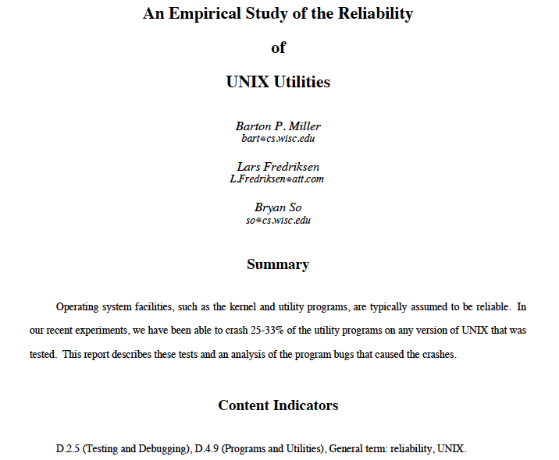

Slide 16
Fuzzing
Fuzzer
UNIX Utilities
%^web3r@#$3423
25%-33%
Random Testing at the System Level

Slide 17
Fuzzer Output
`,a=~F]8b'<Dks}jG[BCO:U65~3+hAO[(qs=z!X?|G_>Ia3<yNm\hO6#R;C-Fkmo\U$5l2qpm"$#QM7',bI{x^B$MXW`JxdguN@Cz2m=]*-T2_IfWJo(&3+QPz j?w+FX:iif ey$~6WykYgC^(GZ[d*Qd6M+O>Gh*TLThD\Sxk`;8J2g'1bPH2bb1O`^LGRZ?MNt>2trkvJ Gm`W|(+4@/\W/ByT7HAsZ#_4}abq)50ghBfs
simple-fuzzer.c

Slide 18
Reasons for Bombing
Arrays and Pointers
Not checking return code of a function
…

Slide 19
Safe Coding Practices
Check all array bounds
Apply bounds on program inputs
Check all return values of a function
Do not trust third-party inputs
All supported by modern programming languages

Slide 20
Cohort Exercise 2
Often input strings are expected to be alphanumeric. Modify the simple fuzzer to generate random alphanumeric strings of length between 0 and 1024. You can use any programming language.
sample-fuzzing-alphanumeric.*

Slide 21

Fuzzer Output
Z(cG*mOGaQ%%SWbFUXVGZin.,Kg5x)a0fM{,3+{Pd=X#s-'^*\m<rG%~Z)"ZWqeJJox'w|dV7$Xb$K)"xl@5=8LW`VFZAqsk,Aaxm0;6bh6H]S+pj=\#M3CwSy\$Ko?`t.tR!@A|gQy[^V$\2!d1'++kx_!7)WTmWE_gHxLKS*cT$\:[AZ01Uv;/LB,Z?1cb]\|*^EL\X%|l#3VE06A=N0z'2X*/hLL?<iBt<Q'\oOFDUy]7)-6e2e>PyNkU7'\!HKiD}H/Z}R8l5?R=U@|qn>930P])<bP33ly$i/(74c$Ntq`r!|`ioyW!1!&:c`JZsAD3CkZ!J?@aF!/7;aNc435.tVL)vSg5;drQBV+T_<NFU!!Ab'U{zvV(g:\N+.X&5i:}?85r] t4#Te?;T~]YVTehejfqY=\}rD*Or~loWfn$4dxQ8u0/JKlFQd5:"X|?P#Z"&VD#l&yswfrNZo(\igNKFf{S&2`l.7O/$trZzrbt`eh/_{Zlz]Vs&=WFMSK,\9huTKuZX"5OB=Fl:O0#&|db/uY&WKm^HB7}xt"mK(]s:/6j)uqIPzh#$h=k4F6r6@?^;2hV]'WrKIAb`WY"CG+fM.npbOzoZ9JAJ@PS?-SxnyVvb({2Ja]b?.1*Y!S`vTRnms$Er9e9'U"+_0<gq>WS*J:I1XJzt\.Dh%C:ePg`7oc[E+db9-?TI.&49O9Z#WNvPmFhUgJmL8v+WSN@o/[;f(RIPkoBabRzDNV$77MBw4\hpkUI)4+K QK3(4ot!xuwosP)
Most Programs reject invalid inputs

Slide 22
Challenge
Z(cG*mOGaQ%%SWbFUXVGZin.,Kg5x)a0fM{,3+{Pd=X#s-'^*\m<rG%~Z)"ZWqeJJox'w|dV7$Xb$K)"xl@5=8LW`VFZAqsk,Aaxm0;6bh6H]S+pj=\#M3CwSy\$Ko?`t.tR!@A|gQy[^V$\2!d1'++kx_!7)WTmWE_gHxLKS*cT$\:[AZ01Uv;/LB,Z?1cb]\|*^EL\X%|l#3VE06A=N0z'2X*/hLL?<iBt<Q'\oOFDUy]7)-6e2e>PyNkU7'\!HKiD}H/Z}R8l5?R=U@|qn>930P])<bP33ly$i/(74c$Ntq`r!|`ioyW!1!&:c`JZsAD3CkZ!J?@aF!/7;aNc435.tVL)vSg5;drQBV+T_<NFU!!Ab'U{zvV(g:\N+.X&5i:}?85r] t4#Te?;T~]YVTehejfqY=\}rD*Or~loWfn$4dxQ8u0/JKlFQd5:"X|?P#Z"&VD#l&yswfrNZo(\igNKFf{S&2`l.7O/$trZzrbt`eh/_{Zlz]Vs&=WFMSK,\9huTKuZX"5OB=Fl:O0#&|db/uY&WKm^HB7}xt"mK(]s:/6j)uqIPzh#$h=k4F6r6@?^;2hV]'WrKIAb`WY"CG+fM.npbOzoZ9JAJ@PS?-SxnyVvb({2Ja]b?.1*Y!S`vTRnms$Er9e9'U"+_0<gq>WS*J:I1XJzt\.Dh%C:ePg`7oc[E+db9-?TI.&49O9Z#WNvPmFhUgJmL8v+WSN@o/[;f(RIPkoBabRzDNV$77MBw4\hpkUI)4+K QK3(4ot!xuwosP)
How do we get a Fuzzer to generate valid inputs?

Slide 23

Idea
ISTDisApillarInSUTDbutItsNameiSGoingToChange
Leverage existing VALID inputs

Slide 24
Mutation
ISTDisApillarInSUTDbutItsNameiSGoingToChange
Trim at a random position
ISTDisApillarInSUTDbutIts
mutation-fuzzer.c

Slide 25
Mutation
ISTDisApillarInSUTDbutItsNameiSGoingToChange
Select a position randomly
ISTDisApillarInSUTDbutItsNameiSGoingToChange
Flip a random bit of the selected position
ISTDisApillarYnSUTDbutItsNameiSGoingToChange
mutation-fuzzer.c

Slide 26
Cohort Exercise 3
Given an input string, implement a mutation operator that choose a random position in the string and swap the adjacent characters. Meaning if SUTD is an input string and 2 is chosen as the random position, the output should be SUDT. Careful about the string length bound check.
mutation-fuzzing-swap.*

Slide 27
Mutation Operators
Flipping a bit
Trimming
Swapping characters
Inserting characters
Mutation operators are chosen at random in every iteration

Slide 28
Cohort Exercise 4
Implement a generalized fuzzer that will take a file, read each line of the file, randomly choose a mutation operator (swap, bit flip or trim) and produce a different file with the modified lines. This means for each input file, the fuzzer will produce one output file, where each line is modified with a random mutation operator. Choose any programming language. Make your program modular so that more mutation operators can be added easily.
mutation-fuzzing.*

Slide 29
Fuzzer Output
Z(cG*mOGaQ%%SWbFUXVGZin.,Kg5x)a0fM{,3+{Pd=X#s-'^*\m<rG%~Z)"ZWqeJJox'w|dV7$Xb$K)"xl@5=8LW`VFZAqsk,Aaxm0;6bh6H]S+pj=\#M3CwSy\$Ko?`t.tR!@A|gQy[^V$\2!d1'++kx_!7)WTmWE_gHxLKS*cT$\:[AZ01Uv;/LB,Z?1cb]\|*^EL\X%|l#3VE06A=N0z'2X*/hLL?<iBt<Q'\oOFDUy]7)-6e2e>PyNkU7'\!HKiD}H/Z}R8l5?R=U@|qn>930P])<bP33ly$i/(74c$Ntq`r!|`ioyW!1!&:c`JZsAD3CkZ!J?@aF!/7;aNc435.tVL)vSg5;drQBV+T_<NFU!!Ab'U{zvV(g:\N+.X&5i:}?85r] t4#Te?;T~]YVTehejfqY=\}rD*Or~loWfn$4dxQ8u0/JKlFQd5:"X|?P#Z"&VD#l&yswfrNZo(\igNKFf{S&2`l.7O/$trZzrbt`eh/_{Zlz]Vs&=WFMSK,\9huTKuZX"5OB=Fl:O0#&|db/uY&WKm^HB7}xt"mK(]s:/6j)uqIPzh#$h=k4F6r6@?^;2hV]'WrKIAb`WY"CG+fM.npbOzoZ9JAJ@PS?-SxnyVvb({2Ja]b?.1*Y!S`vTRnms$Er9e9'U"+_0<gq>WS*J:I1XJzt\.Dh%C:ePg`7oc[E+db9-?TI.&49O9Z#WNvPmFhUgJmL8v+WSN@o/[;f(RIPkoBabRzDNV$77MBw4\hpkUI)4+K QK3(4ot!xuwosP)
Parser
The parser rejects invalid input

Slide 30
Idea
Parser
Get a format of the valid inputs

Slide 31
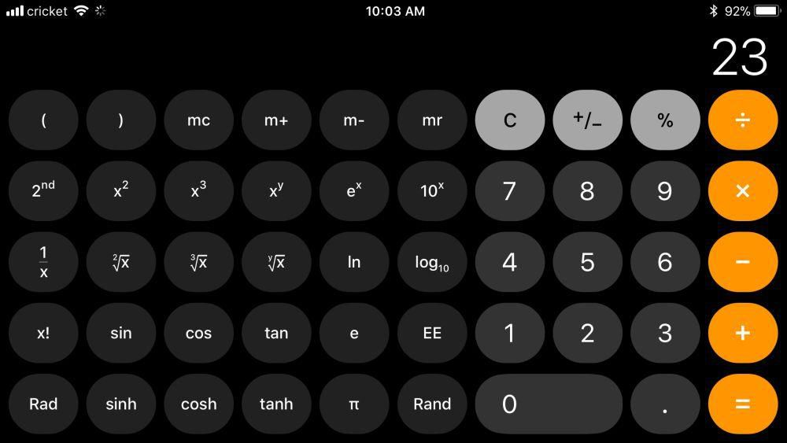
Idea
Calculator
Parser
Calculator supports arithmetic expressions

Slide 32
Idea
Calculator
Parser
1+3, 3+1/2, 4*(5+1)-1 are valid inputs

Slide 33
Idea
Calculator
Parser
1/*1, +-21/12, 2---- are invalid inputs

Slide 34
Idea
S := Expr
Expr := Expr + Term | Expr – Term | Term
Term := Term * Factor | Term / Factor | Factor
Factor := -Integer | (Expr) | Integer | Integer.Integer
Integer := Digit | IntegerDigit
Digit := 0 | 1 | 2 | 3 | 4 | 5 | 6 | 7 | 8 | 9
Rules
Capture valid inputs by a grammar

Slide 35
Derivation of inputs from grammar
S
Expr
Expr
+
Term
Term
Generates 5+2*3
Term
*
Factor
Factor
Factor
Integer
Integer
Integer
3
5
2
Capture valid inputs by a grammar

Slide 36
Cohort Exercise 5
Draw the derivation tree for input (23 * 56) / (1.2 + 2)

Slide 37
Cohort Exercise 6
Use any programming language to implement a fuzzer that will randomly generate inputs to the calculator conforming to the grammar. Make your program modular in the sense that it can work with any grammar, as long as it is available.
Hint: Start with the initial rule S := Expr and at each point, apply a rule at random. For example, randomly choose any of the rule Expr := Term, Expr := Expr + Term or Expr – Term in the next step. Continue until a valid expression for the calculator is obtained.
calculator-grammar-fuzzing.*

Slide 38
Web System Testing
Automated testing of web application is often required
To test UI activities
Checking links and connections
Submitting web forms
More…

Slide 39




Web System Testing
Firefox (gecko) Driver
Google Chrome Driver
Test Code
Converts to browser
specific actions

Slide 40
Link Objects
Find a link in a webpage with a given name and click the link
OpenLinkName.java

Slide 41
Link Objects
Find all link objects in a webpage. Click on all these links.
FindAllLink.java; FindAndClickAllLinks.java

Slide 42
Cohort Exercise 7
Test the new istd.sutd.edu.sg webpage by randomly clicking links. The process may go on forever.
MonkeyTestISTD.java

Slide 43
Filling Button Texts
Fill up login and password and login to your Google account automatically. Order food by a program.
FindMessageText.java; OrderFoodWithBot.java

Slide 44
Cohort Exercise 8
Extend the food ordering bot to show a list of restaurants in your area once you are logged in.
OrderFoodWithBotExtended.java

Slide 45
Explicit Wait
Consider the Google login example. We do not need to wait always 10 seconds. We only need to wait until the “password” field becomes visible in the page. Selenium provides the class ExpectedCondition for this purpose.
ExplicitWaitGoogleLogin.java

Slide 46
Cohort Exercise 9
Write a test to do the following: Send 20 invalid usernames to Google login form (be innovative about the invalid user names) and then login with your user name and password.
LoginBotWithInvalidValidUser.java

Slide 47
Checking Broken Links
Finding and clicking all links still require a human observer to check what is happening with the software. It will be useful if all links are checked automatically for potential breakage.
BrokenLinkFinder.java

Slide 48
Cohort Exercise 10
Write a test to check whether all web pages directly reachable from a given webpage have titles. The test will fail if any such directly reachable webpage has an empty title. Hint: Use getTitle() from the web driver.
HeaderNameFinder.java

Slide 49
More on Web App Testing
https://www.guru99.com/accessing-forms-in-webdriver.html

Slide 50


Summary of Week 5&6
Test Execution Framework / Test Driver

Slide 51
Summary of Week 5&6
Test Design
Blackbox Testing
Equivalence class partitioning
Boundary value analysis
Whitebox Testing
Coverage guided testing
Statement, branch, condition, loop, method, path coverage
Fault guided testing
Locate potentially faulty statements
Backward reasoning to find inputs leading to faults
System/robustness testing
Fuzzing (monkey test)
Mutation-based fuzzing
Grammar-based fuzzing
Application-specific testing
Web application testing

